Slide 1

Introduction to Software Business Product management
Week 3 Day 2
Led by: Emily Crose
for
Oakland University

Slide 2

Review of day 1

Slide 3

Questions From Day 1?

Slide 4
Terms to listen for
UX/UI/Interface
The visual elements of our application

Slide 5
The Software Development Life Cycle

Slide 6
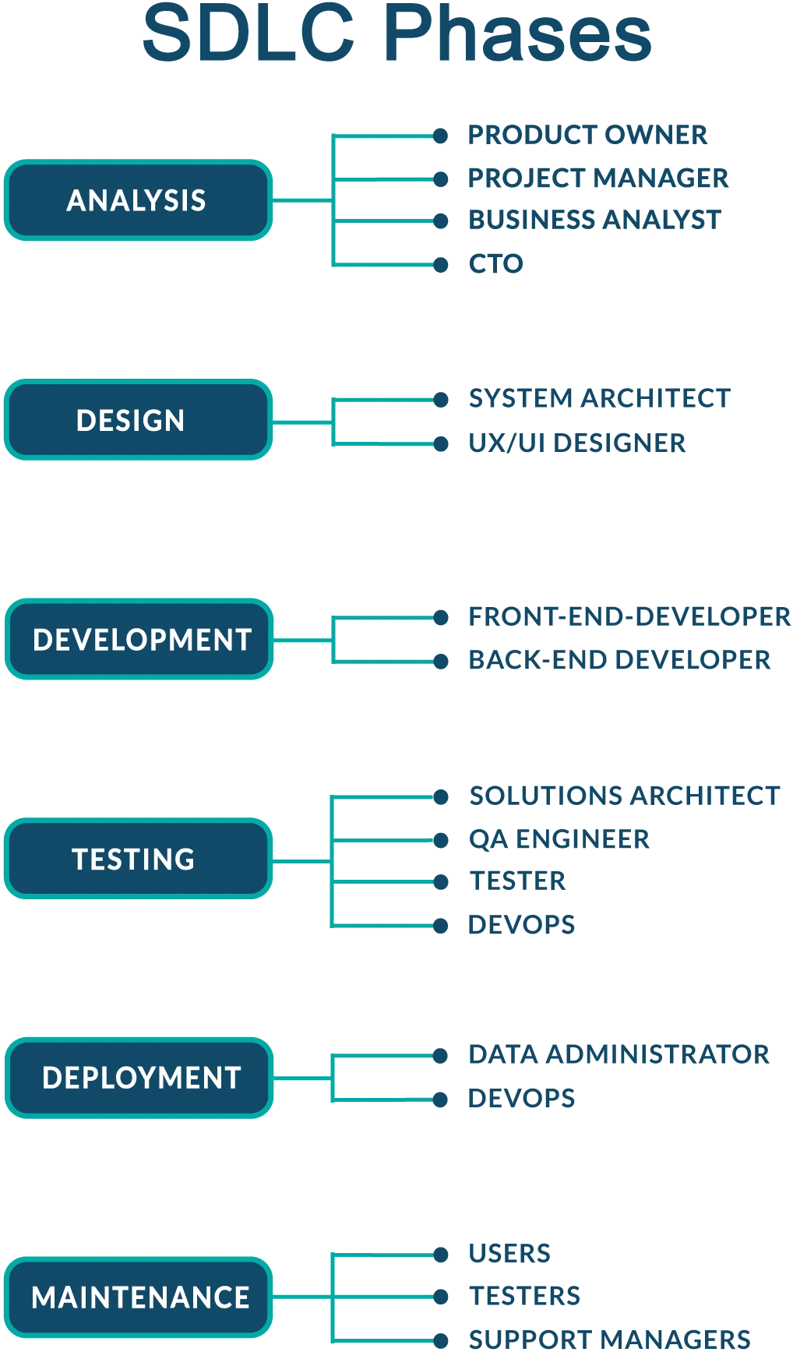
Notes:
If you’re taking notes, you’ll notice that this slide diverges from the last presentation of the SDLC. This isn’t a serious issue for us though, what we want to take away from the information we see here is the jist of planning, development, feedback, and beginning the cycle anew.

Slide 7

Design stage

Slide 8

We’ve decided to make some software!
(Now what?)

Slide 9
Design roles
System architect
UX Designer

Slide 10
Design activities
UX mockups
Database requirements
prototyping
Notes:
So these are the activities we will expect to be working with when we go to design our product.

Slide 11
development

Slide 12
Testing stage

Slide 13
deployment

Slide 14
maintenance

Slide 15
Notes:
And once we finish our SDLC, we start all over again!

Slide 16

Review Day 2

Slide 17

Question or clarifications?

Slide 18

Preview day 3

Slide 19

See you next time!

